Slide 1
PROG6212 PART 3 CMS SYSTEM VHUGALA MBEDZI ST10452694

Slide 2
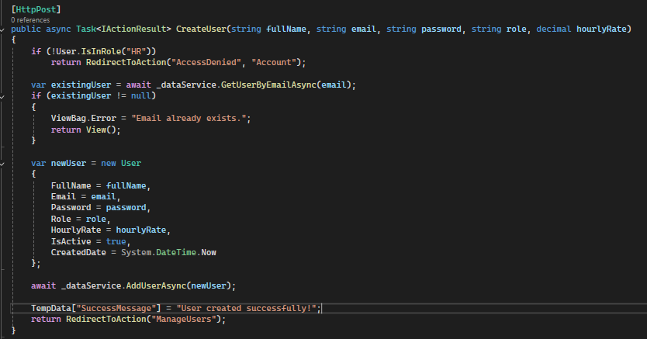
HR USER MANAGEMENT
In my Accounts controller this code acts as a super user , its function is to create all profiles with no self registration and sets hourly rates as well.

Slide 3
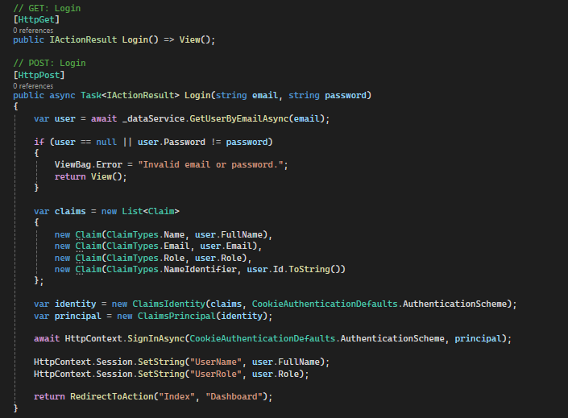
SESSION MANAGEMENT
This code handles session management in my AccountsController , its use is to store user identity and it enables role-based access control throughout my app.

Slide 4
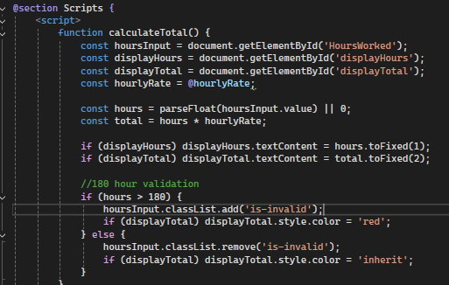
Lecturer Auto-Calculation
This code is from my Claims Create View that implements Auto calculation , and 180 hour validation

Slide 5
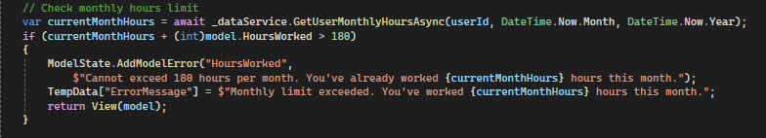
LECTURER AUTO-CALCULATION
This is my Auto Calculation code from my ClaimsController which implements auto calculation , 180 hour validation working alongside claims create view I pasted above.

Slide 6
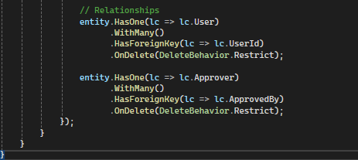
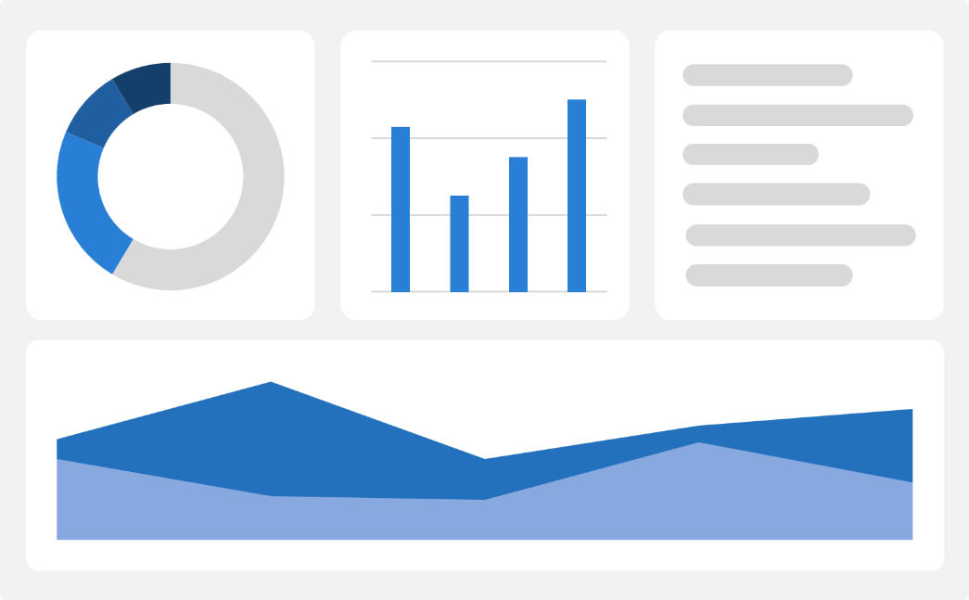
Entity Framework and Database relationships
This code from my AppDbContext implements EF relationships , navigation properties and databse contraints.Note the code is under modelBuilder entity for lecturer claim

Slide 7

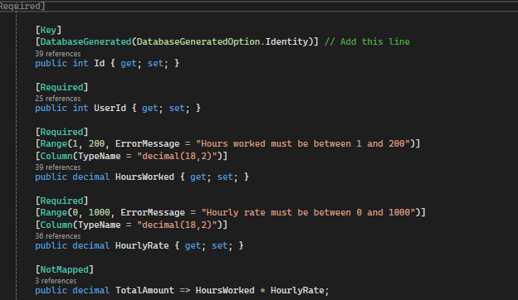
Entity Framework & Database Relationships
This is from my LecturerClaim model this code works alongside the code from the previous page in the AppDbContext class , allowing proper EF relationships , navigation properties , computed properties and databse constraints in my app .

Slide 8
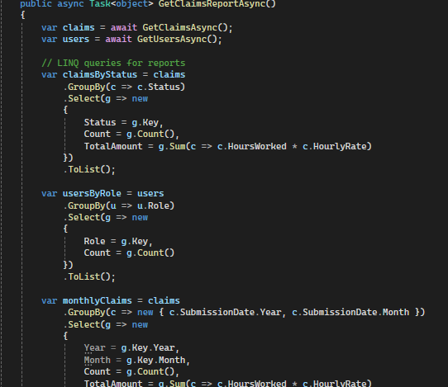
LINQ REPORTING
I have additional code under that relates to this .

Slide 9
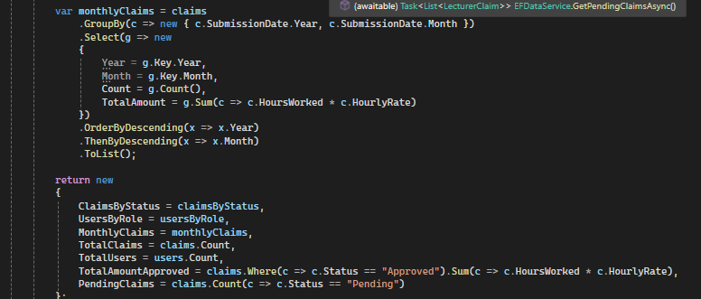
This code and the one on the previos page from my EFDataService class performs grouping aggregation and sorting .

Slide 10

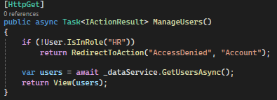
Role-based authorization
These two code snippets are from my Coordinator Controller and accounts controller , they are code that implement multi level authorization . As well as the screenshot on the following page.

Slide 11
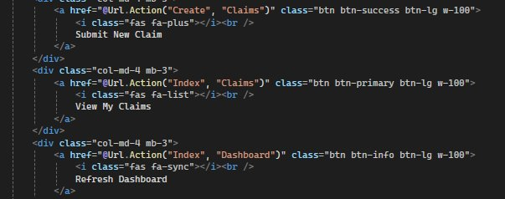

Slide 12
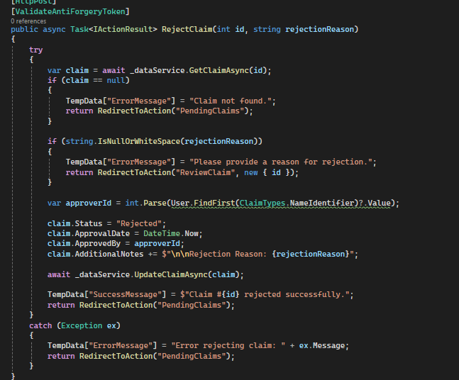
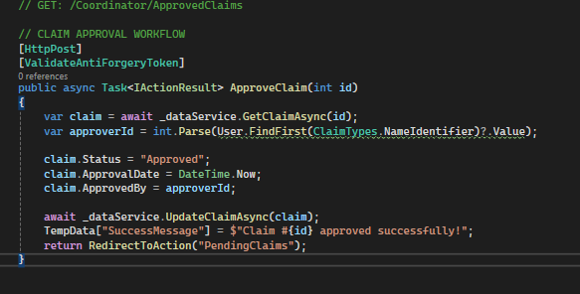
Coordinator Approval and Reject

Slide 13
Screenshots above
In the above slide I pasted screenshots of my reject and approve functions in the coordinator dashboard .Used to approve and reject claims.

